Slide 1

Bauska, Move!
Rihards Žilionis, Annija Vītoliņa, Sofia Ogorodnikova, Dilobarhon Tojiboeva, Roberta Zvejniece, Emīls Kraģis, Kristiāna Jaunpetroviča
Notes:
EMILS

Slide 2
What are we doing? And why?
Digitalized sightseeing routes
Annual cycling Unity Ride
Digital solutions:
QR codes that lead to a webpage
Webpage containing tasks and information
(easy to use on smartphones)
Custom Google maps with route and attraction points visible
Notes:
RIHARDS

Slide 3
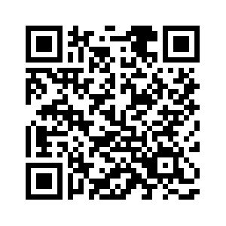
QR codes
Used for sightseeing route
Code leads to webpage with tasks to do at attraction points
Using online generators
Still need to find cheaper alternative
QR code to ORTUS
Notes:
ROBERTA

Slide 4
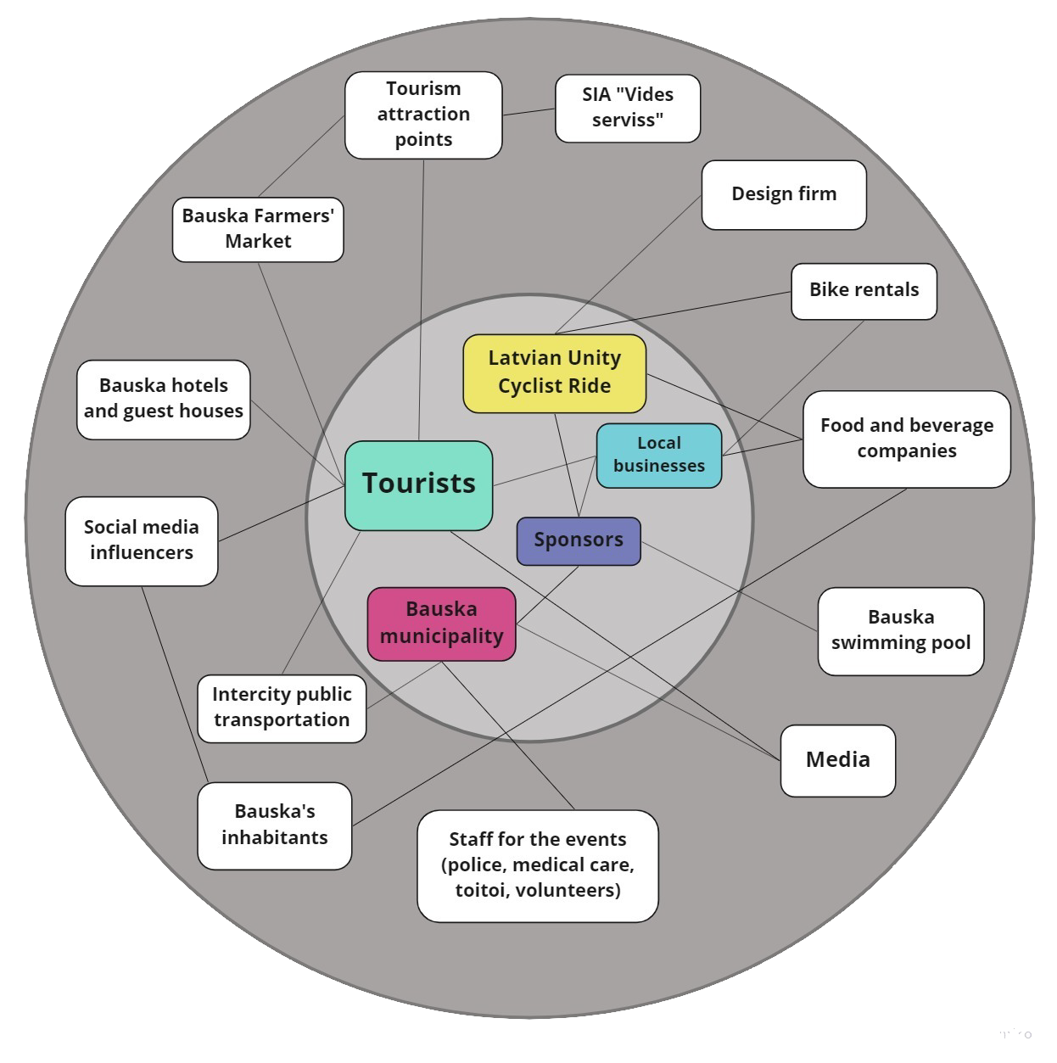
Stakeholders - then
The main points:
The Latvian Cyclist Unity Ride
The municipality of Bauska
The roads in Bauska
Locals
Attraction points
Notes:
ANNIJA

Slide 5
What do we know
The Unity Ride interests people
Quality of roads
Possible routes for the Unity Ride
Previous cycling event ending
Shutting down roads
Existing cycling routes, attraction points
Existing bike rental
Notes:
EMILS

Slide 6
Stakeholders - now
Municipality - interested in creating the annual Unity Ride
The Latvian Cyclist Unity Ride - interested in cooperating with Bauska
Tourism attraction points - enough to explore the city and digitalisations
Bike rental interested in collaborations
Mostly the ones in the gray circle are not that important and will be touched if the event will actually take place.
Notes:
ANNIJA

Slide 7
Problems facing
Attracting sponsors
Municipality’s activity and participation in organising
Unknown number of possible participants
Unity Ride gathering place
There are no locals who could help to organize The Unity Ride
Notes:
KRISTIANA

Slide 8
Ideas yet to clarify
The complete route for the Unity ride (most likely including Mežotne castle, Rundāle castle and Bauska castle)
Monitoring roads during the Unity ride
The complete route for Bauskas exploration game/route
Marketing plan/advertisement
The interface and functions of the website
Notes:
SOFIA

Slide 9
Solution date ~ November 15th

Slide 10
Some bottlenecks
Issues with putting the information on Bauskas information webpage server
Others may accour troughout the way
Notes:
SAM

Slide 11

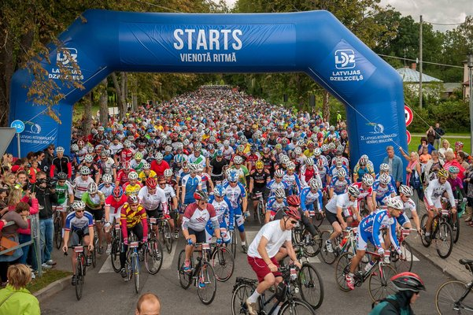
We are working and it’s coming

